Slide 1

Think Developmentally!
Linking Classroom Practice to Social Emotional Learning
An Introduction to Developmental Therapy-Teaching
Assessment, Achievement, Accountability
Developmental Therapy Institute, Inc.
www.developmentaltherapyinstitute.org
dti@developmentaltherapyinstitute.org
.
© 2017, Content of slides 1–41, Developmental Therapy Institute, Inc. For authorization to use all or part of this PowerPoint presentation, contact the Developmental Therapy Institute.

Slide 2
Four basic beliefs emphasize every student’s capability to learn success-producing behavior!

Slide 3
Beliefs about Teaching and Learning that Guide DTT
Focus on Strengths
Follow Developmental Guidelines
Provide Pleasure and Success
Make Experiences Relevant
Notes:
Refer to handout #1 for a summary of these DTT foundation beliefs.

Slide 4
Developmental Therapy-Teaching (DTT)
applies these beliefs to social-emotional learning
At every age and stage of development,
social-emotional and behavioral changes are occurring.
DTT Guides this process to positive outcomes
for all children.

Slide 5
From little kids to teens … they all
Behave, Speak, Relate, and Think
These are the essentials for social-emotional development …
In four developmental domains!

Slide 6
The next four slides summarize the DTT content in each domain:
Behavior, Communication,
Socialization, and Cognition.
Within each domain key
competencies are needed by all children to be
successful in school (and in life).

Slide 7
DEVELOPMENTAL STRANDS IN BEHAVIOR
:
SOCIAL RESPONSIBILITY
PERSONAL RESPONSIBILITY
GROUP CONFORMITY
EXPLORATORY ACTIVITY
SENSORI-MOTOR
Beginning here

Slide 8
DEVELOPMENTAL STRANDS IN COMMUNICATION
ABSTRACT, IDEA-ORIENTED LANGUAGE
SELF EXPRESSION IN SOCIAL EXCHANGES
SOCIALIZED LANGUAGE
SPONTANEOUS LANGUAGE
PREVERBAL SPEECH
Beginning here

Slide 9
DEVELOPMENTAL STRANDS IN SOCIALIZATION
THE SOCIAL SELF
SOCIAL UNIFORMITY
IDENTITY
AUTONOMY & MASTERY
ATTACHMENT
Beginning here

Slide 10
DEVELOPMENTAL STRANDS IN
COGNITION
ABSTRACT THOUGHT & LOGIC
CONCEPT FORMATION
BODY SKILLS & GAMES
SENSORI-MOTOR
&
MEMORY
Beginning here

Slide 11
Why are these developmental strands essential for every individual?
These strands are the content of developmental stages.
They define how well a person copes with the tasks of learning and life.
They shape everyday experiences into what an individual becomes.
They continue to expand as a life-long part of a person’s personality.

Slide 12
Developmental Therapy-Teaching (DTT)
Organizes these domain strands into 5 age-related stages with competencies for sequential teaching within each stage.

Slide 13
?
How is a
student’s stage identified
and used
?
Assess a student’s achieved competencies to identify the current developmental stage with the DTORF-R or E-DTORF
Find the age-related cluster of competencies NOT achieved for the student’s current instructional stage
Use the instructional stage for planning IEP & BIP goals and objectives, teaching practices, and behavior supports
Repeat rating at intervals to adjust instruction for achievement of the selected competencies
Notes:
Refer to Handout #2, DTT Goals and Objectives

Slide 14
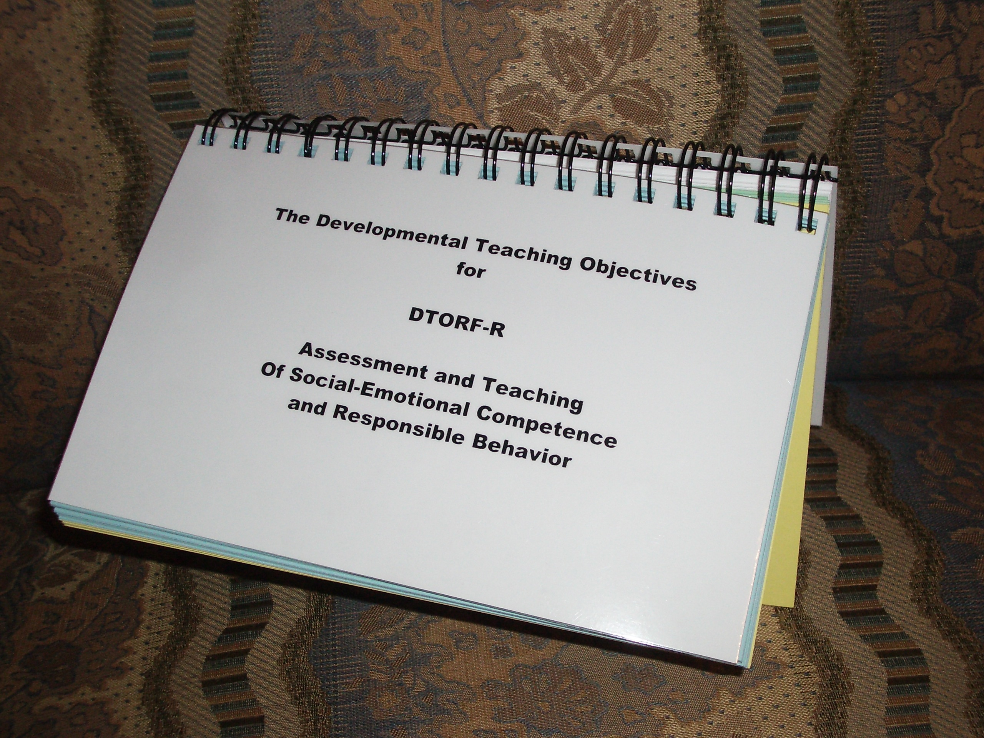
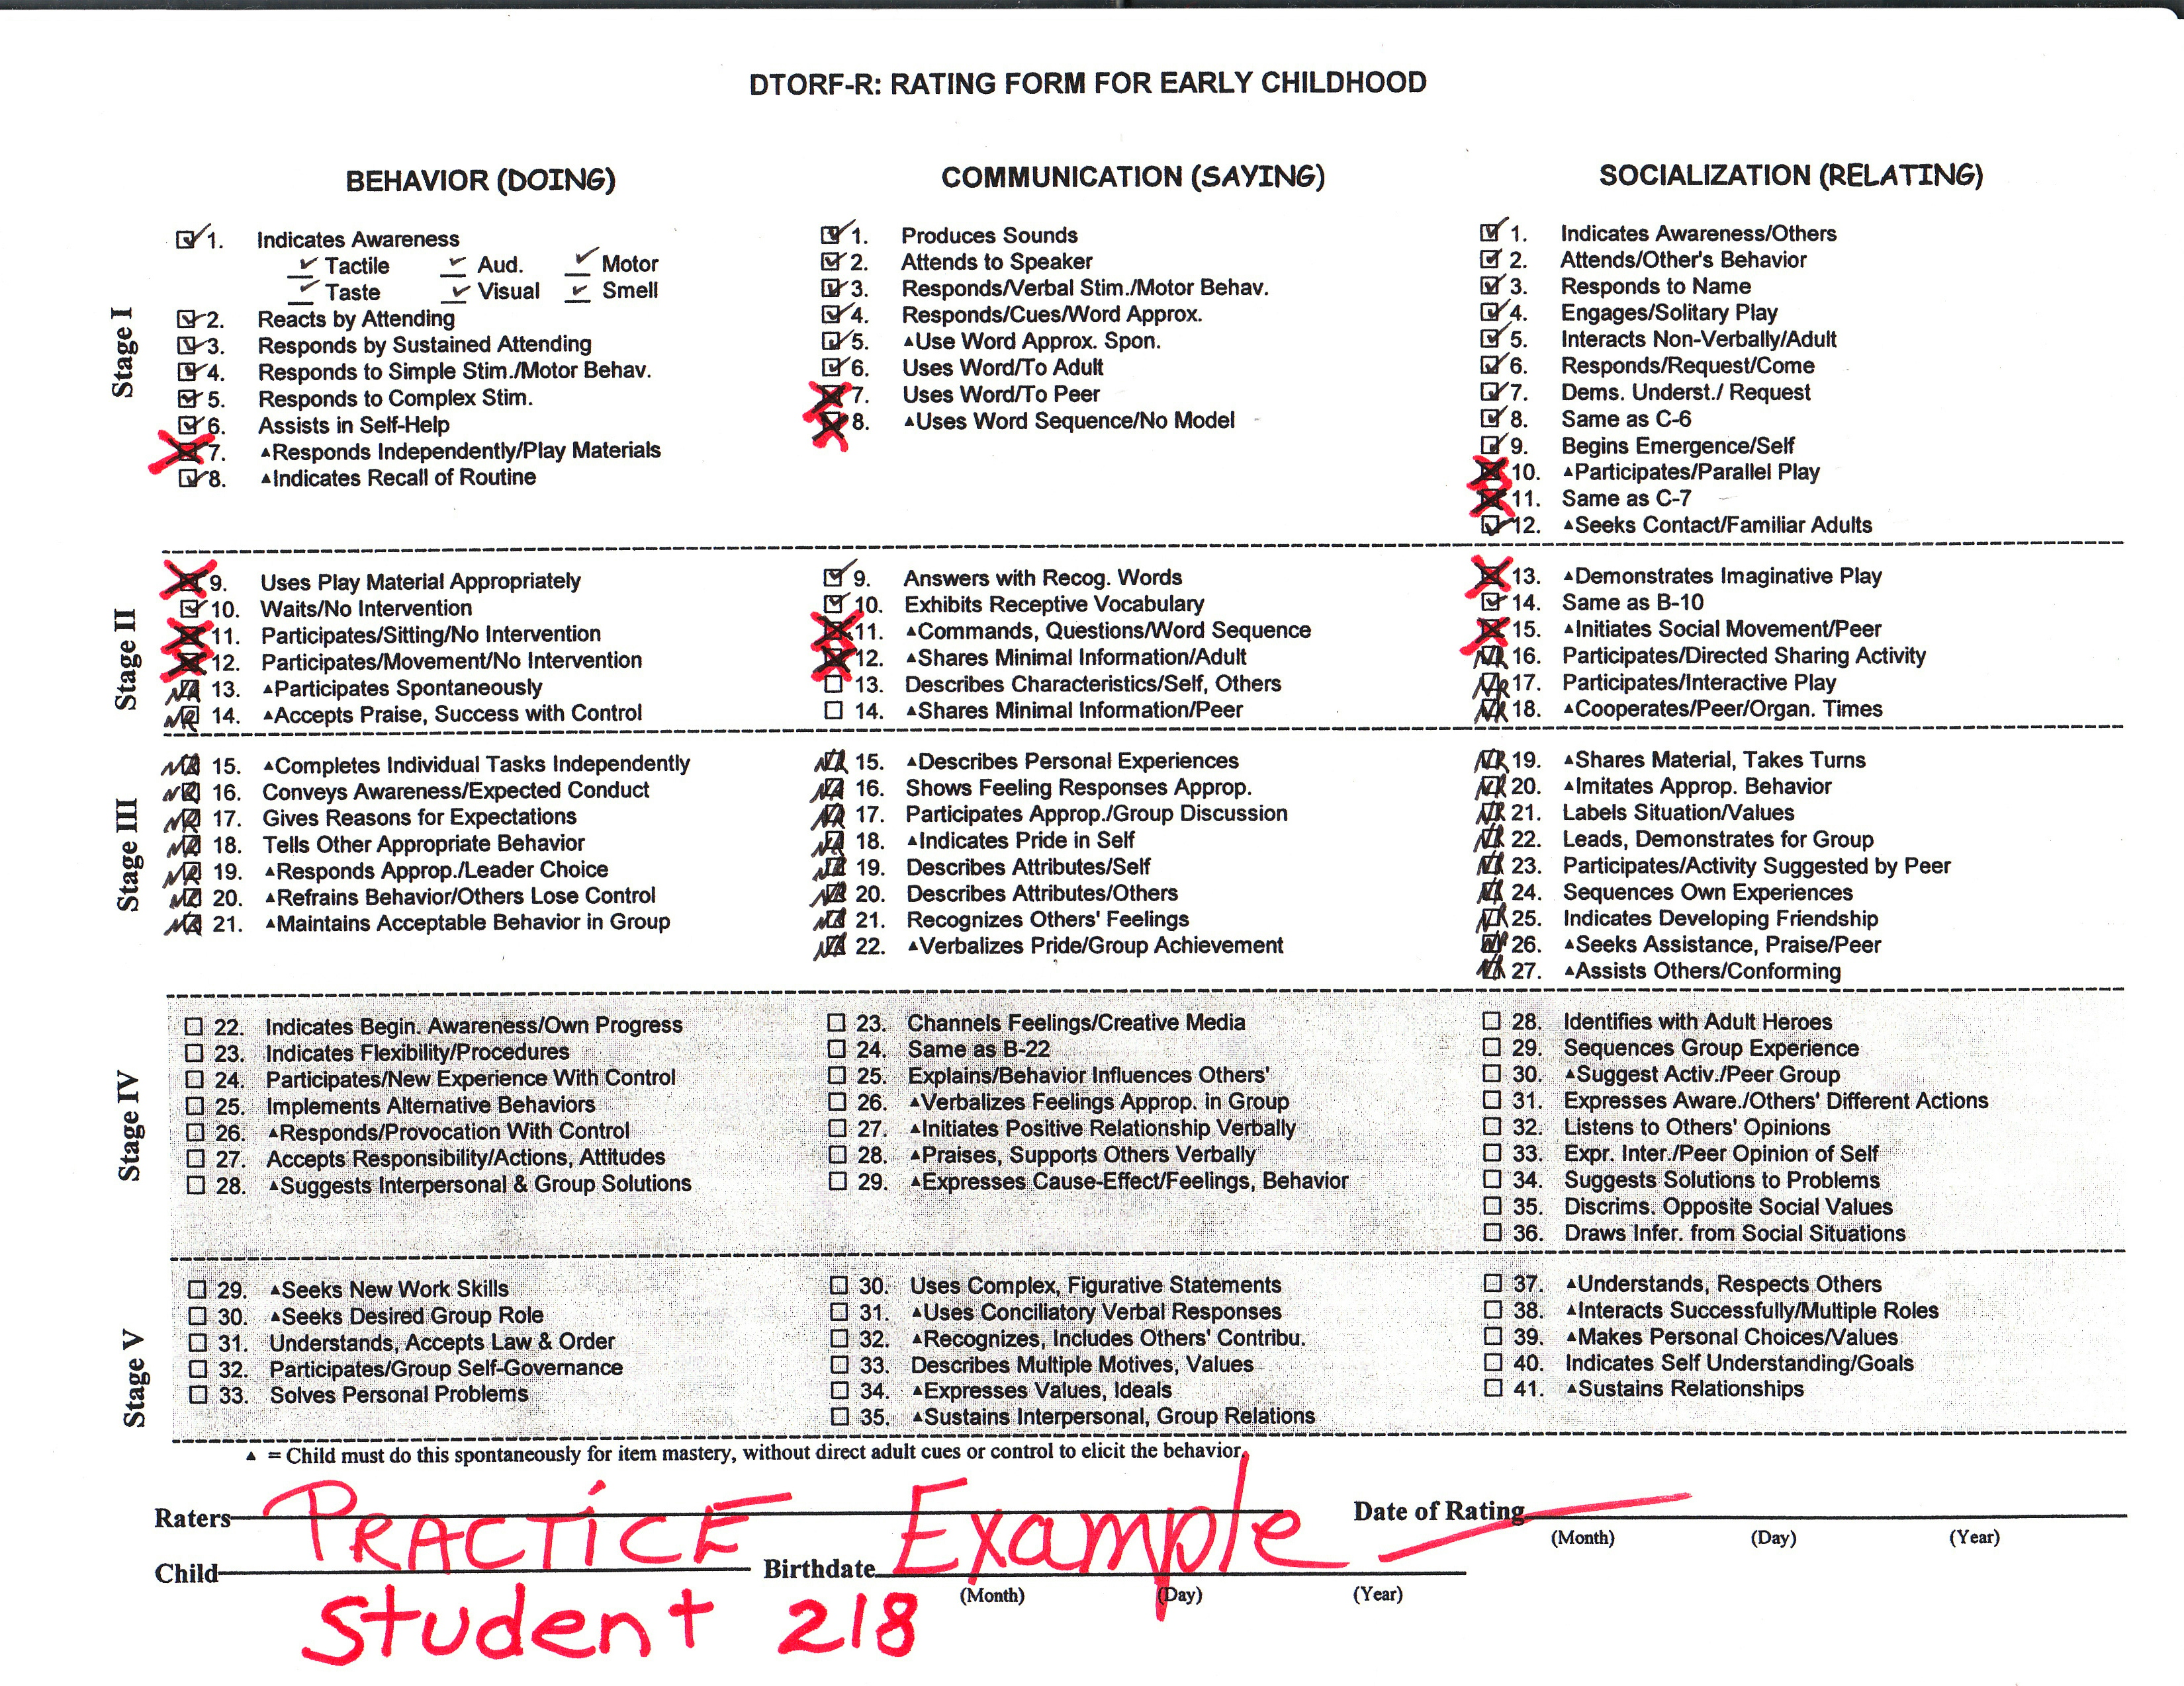
DTORF-R
(Developmental Teaching Objectives
and Rating Forms-Revised)
print and online versions

Slide 15
DTORF-R is… NOT Your Typical Developmental Assessment Instrument!
Uses observational ratings of students’ behavior in home, school, and neighborhood
Identifies skills students have mastered, need to work on, and not developmentally prepared to work on
Ratings by team consensus
Self-rating may be done by older students

Slide 16
DTORF-R is… a growth-based behavioral rating instrument defining student competencies in the four DTT developmental domains.
BEHAVIOR
COMMUNICATION
SOCIALIZATION
COGNITION
Developmentally sequenced
For students
pre/k - grade 12
Partners with any intervention, academics, or social skills program
Doing
Saying
Relating
Thinking

Slide 17
DTORF-R Ratings are Used to…
Identify students in need of referral for additional supports
Make IEP decisions about placement and grouping of students
Identify instructional objectives in Behavior, Communication, Socialization, and Cognition
Plan instructional activities to foster achievement of developmental objectives
Document student progress with metrics for analyses

Slide 18
In Brief, DTORF-R is… Designed to be Part of a Comprehensive Assessment
DTORF-R contributes a developmental dimension to standard psychological, behavioral, and educational assessments.
It is especially useful when social-emotional and behavioral skills need to be included in an IEP.
It provides direct links to stage-related teaching practices and behavioral supports.

Slide 19
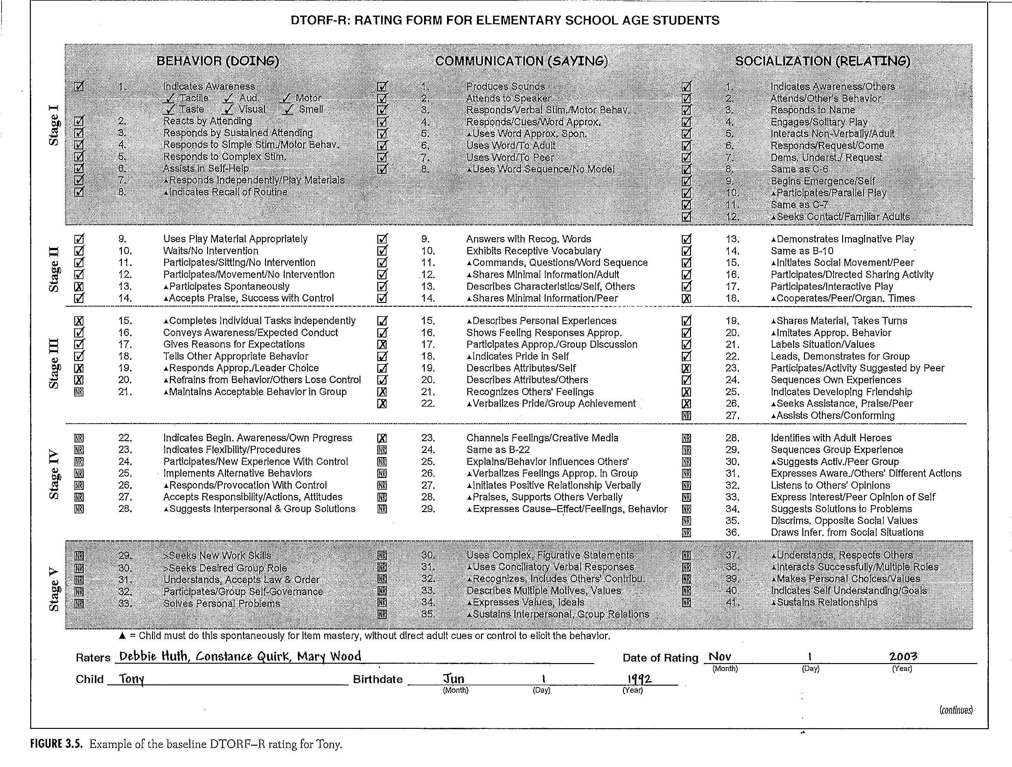
Example of a DTORF-R Rating, page 1

Slide 20
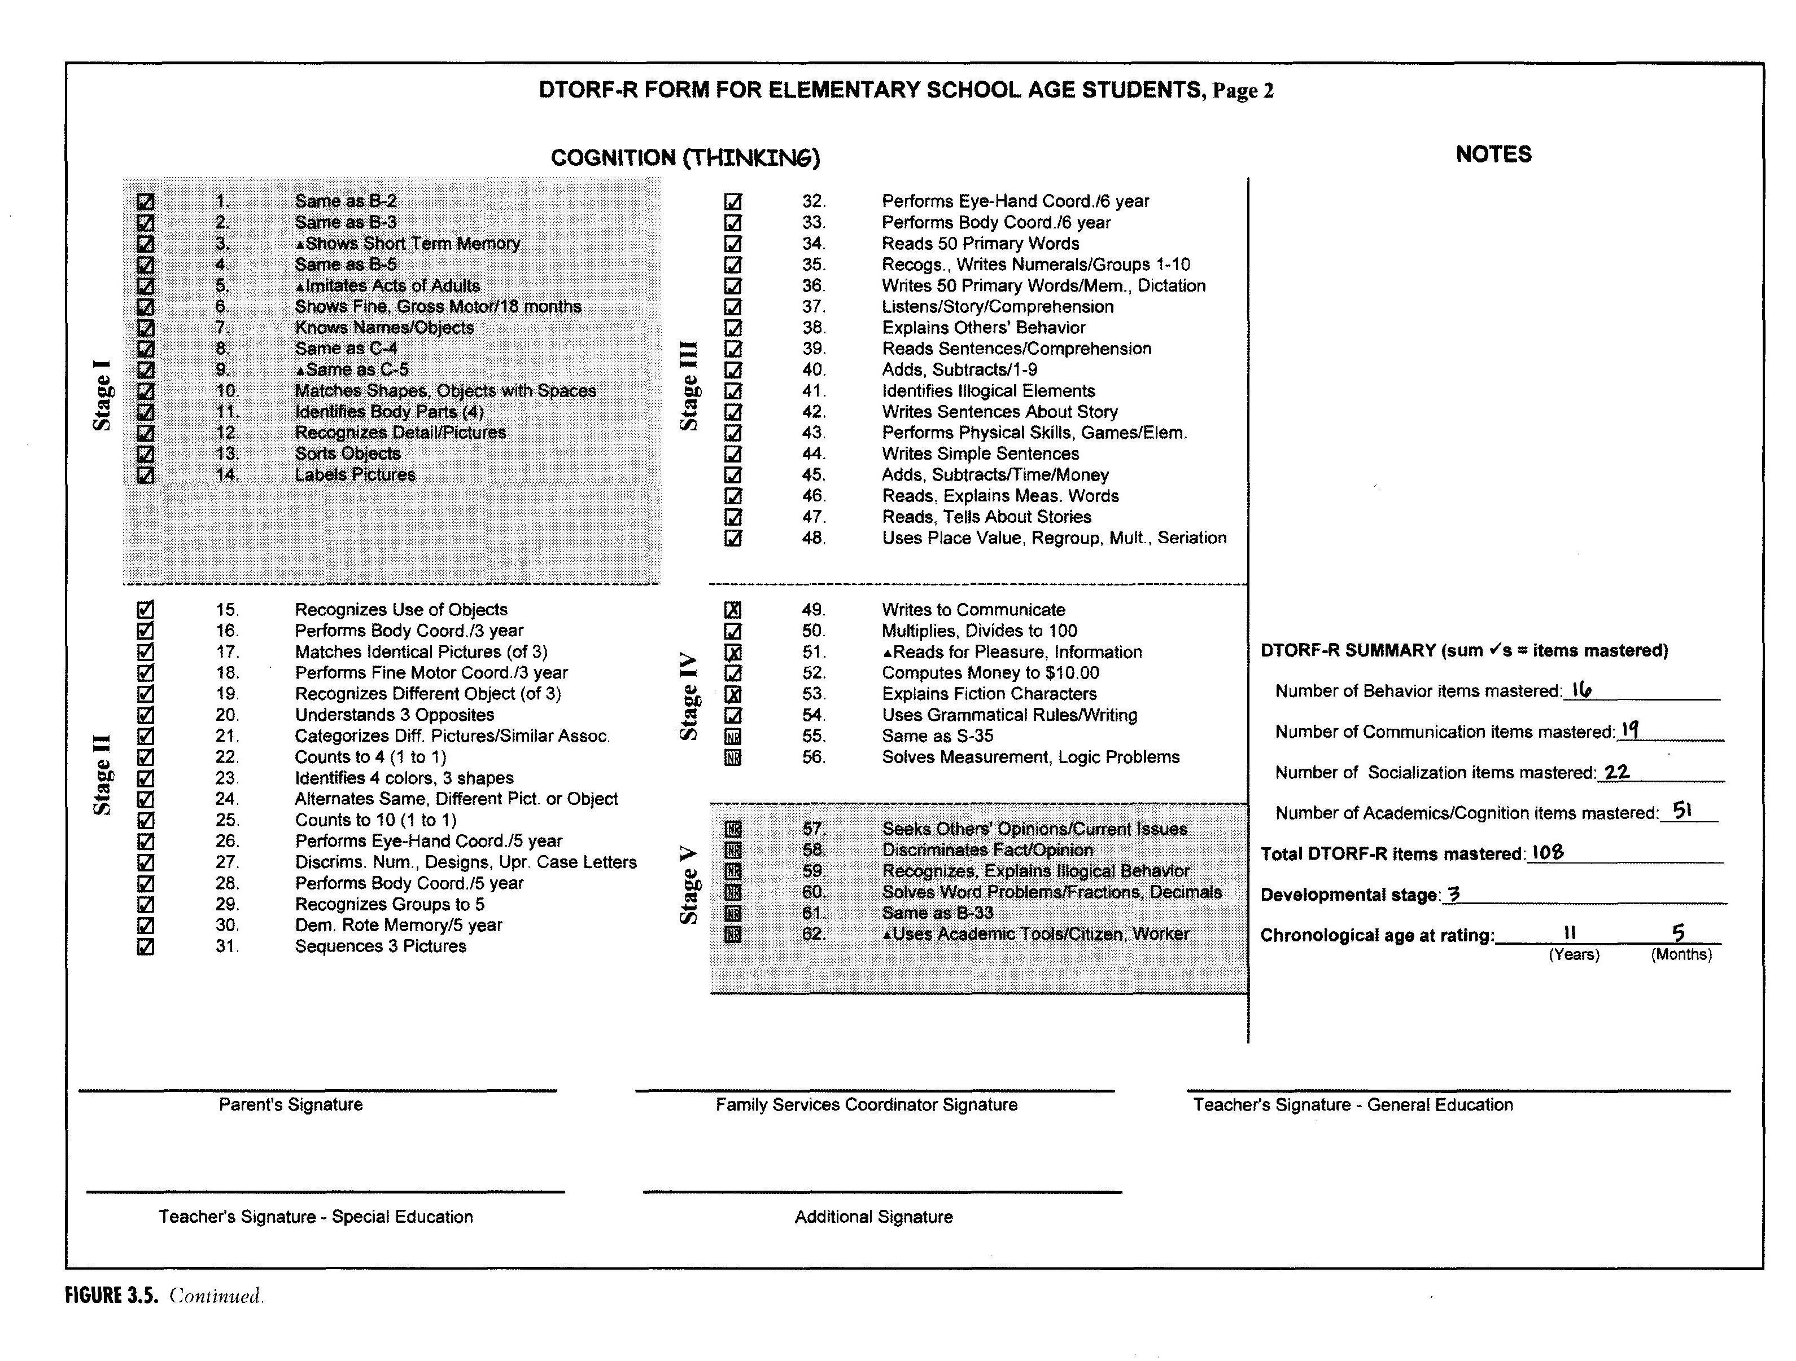
Example of a DTORF-R Rating, page 2

Slide 21
DTORF-R Rating Rules:
Every DTORF-R competency statement is rated sequentially in one of three ways:
✔ = Consistently demonstrates the competency in all settings.
X = Ready to work on the competency or needs to continue for mastery.
NR = Not ready yet; prerequisite competencies are not yet mastered.

Slide 22
Competencies rated X in each domain become
current IEP objectives and instructional stage
Each instructional stage also has recommended positive behavioral supports for a BIP
[Behavioral Intervention Plan]
]
Strategies used extensively
Strategies used frequently as needed
Strategies infrequently, as needed

Slide 23
A 3-person rating
team is recommended: teachers, parents, paraprofessionals, and other professionals on a service team.
At least one team member should have reliability training in the DTORF-R.
Older students are encouraged to
participate in their
ratings.
?
Who
Does the
Rating
?
How Reliable is a Rating?
Ratings have high statistical reliability.
Research results are in the User’s Manual.

Slide 24
How Valid
is
the Content
?
Content analysis charts are
in the
User’s Manual
Every DTORF-R Competency Meets These Standards:
Observable competency, not a deficit
Identified from research on child and personality development
Occurs in sequence of increased difficulty
Internal consistency across domains
Desired competencies for age peers
Conveys clear meaning for parents and professionals

Slide 25
NOW, About Instruction …
When an IEP includes specific DTORF-R goals and objectives in each domain, you have the key characteristics for social-emotional learning.

Slide 26
How Does a DTORF-R Rating
Guide Instruction ?
DTORF-R competencies not mastered become IEP objectives and indicate the current stage where instruction should begin across the four content domains
Each stage has specific developmentally matched teaching practices and positive behavioral supports

Slide 27
Use developmentally matched BEHAVORAL SUPPORTS.
TEACH for competencies.
REPEAT process at each rating period.
Design ACTIVITIES, MATERIALS, CONTENT to achieve competencies.
Repeat DTORF-R rating:
Competencies Achieved?
What Next? Plan instruction from
a DTORF-R Rating …
Select NEW competencies
modify instruction,
or exit program.

Slide 28
? ? How do Teachers Change Instruction from Stage to Stage ?
DTT teachers adjust instruction—goals, content, materials, learning environments, and
behavioral supports—to students’ stages of development. They also adjust their roles as significant adults, mentors, and role models.

Slide 29
Help for Teachers: the Developmental Teaching Inventory of Teacher Skills (DTRITS)
Self-assessment of teaching practices matched to students’ developmental stages
Observation tool to assess additional professional needs of teaching teams
A tool for program development relating fidelity of teacher practices to student progress

Slide 30
DTT Empowers a Teaching Team to…
Focus on social-emotional and behavioral objectives
Listen and respond with empathy
Decode a student’s surface behavior
Use developmentally appropriate behavioral supports
Demonstrate the psychological importance of schedule, materials, and activities
Adjust adults roles to a student’s stage of development

Slide 31
Behave, Speak, Relate, and Think
Linking Assessment to Accountability
Every year teachers are asked to document how classroom practices are effecting change and student outcomes
With DTT, you have several options for demonstrating how assessment and classroom practices result in student progress

Slide 32
A Rating Team can Predict IEP Outcome Goals for Each Domain
Example of predicted outcome goals and objectives for BEHAVIOR domain
1. Student currently demonstrates 3 of the 7 competencies in Stage Three in Behavior.
2. By the end of this IEP [June], student will demonstrate the use of 6 of the 7 behavior competencies in Stage Three, with 90% mastery.
3. The overall behavioral goal for student in Stage Three is to use acceptable behavior in a group.

Slide 33
Example of an Individual Student Progress Record Started Online
Pause to Practice:
Refer to Worksheet for Baseline Summary

Slide 34
REPORTING STUDENT PROGRESS—How Often?
Repeated ratings are scheduled to coincide with school rating /grading periods
Repeated ratings can be reported for individuals or aggregated for group progress, trends, and for descriptive or inferential statistics

Slide 35
Student’s End-of-Year Rating is Added to the Online Progress Record
Pause to Practice:
Refer to Worksheet for Student’s End-of-Year Summary

Slide 36
What to do With These Results?
Option 1: Pre- to post- comparison of a student’s scores (c. 4).
Option 2: Comparison to age peer score (c. 9).
Option 3: Comparison with pre-intervention rate of item mastery (c. 6).
Notes:
A simple pre-post comparison (108 to 117) gain of 9 items in 7 months (about 1 competency + per month).
With 84% post- comparison, Tony made gains against the baseline of 79% [90% + would be expected age level].
Multiply pre-intervention rate of item mastery (.7883) by 7 months to second rating (5.5181) and add to baseline score (108 + 6 =115) predicted score without intervention.

Slide 37
Examples of Options for Reporting Progress
Pre-post comparison (108 to 117) shows Tony gained 9 competencies in 17 months. Comparing to age peers, the gap has narrowed from 79% at baseline to 84% at end of school year.
Pre-intervention rate (.79) multiplied by 7 months added to baseline score (108) gives an estimate of an end of year score (115) without the current intervention program.

Slide 38
No E-DTORF ? You Can Calculate Summary Options Manually
You will need:
Student’s age in months and total DTORF-R score (items mastered) at baseline
Months between each rating
Age peer scores found in the Developmental Age Scores tables, DTORF-R User’s Manual

Slide 39
Example: An Easy Do-It-Yourself Option to Summarize Student Annual Progress
Domain | Baseline competencies achieved — November | End of year competencies achieved — June | Gain in Milestone Competencies
BEHAVIOR | 16 | 20 | +4
COMMUNICATON | 19 | 21 | +2
SOCIALIZATION | 22 | 23 | +1
COGNITION TOTAL | 51__ 108 | 53__ 117 | +2__ +9

Slide 40
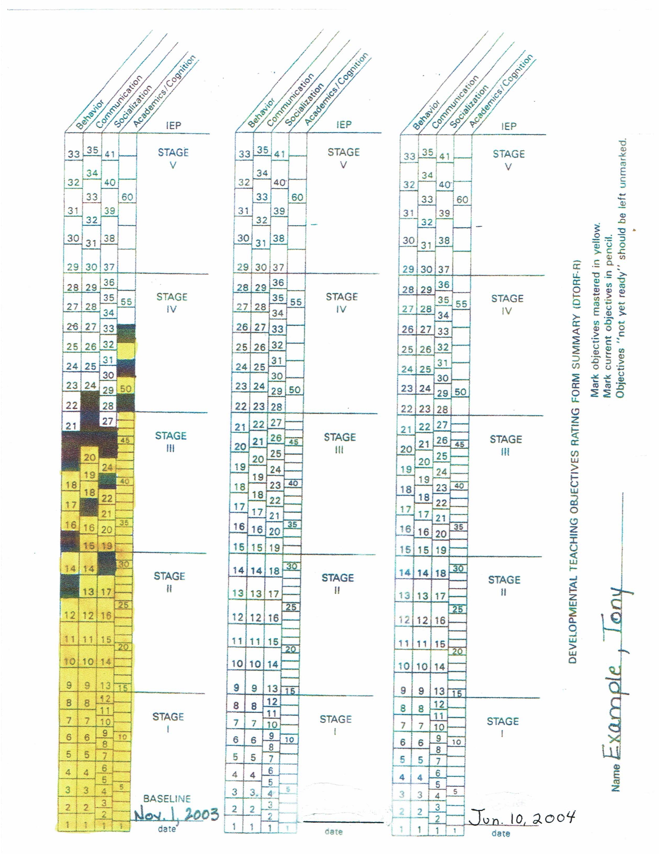
Another Do-It-Yourself Option:
Color-Coded Bar Graph
Yellow cells = competencies.
Penciled cells = current objectives
Mid year and final DTORF-R
ratings are added to illustrate student progress visually.

Slide 41
Aggregating Group Data
Scores must be ratings during similar time intervals
Intervals less than 2 months or greater than 9 months should be excluded

Slide 42
Example: Statistical Comparison
Pre- to Post-Outcome Scores
for 2,082 Students
[using paired sample t-tests]
 | N | Mean Initial Score | Mean Final Score
PreK/Elementary Age | 483 | 81.61 | 87.97*
Middle School Age | 605 | 100.26 | 104.30*
High School Age | 994 | 111.50 | 115.57*
*statistically significant progress (p value <.0001)

Slide 43
Example: Students’ Pre- to Post-
Outcome Scores at Center Based
and School Based Locations
[using paired sample t-tests]
 | N Students | Mean Initial Score | Mean Final Score
Center Based | 1,276 | 97.85 | 102.03*
School Based | 774 | 107. | 112 .77*
*statistically significant progress (p value <.0001)

Slide 44
To Close: Accountability Can Be
Easy and Efficient — Online DTORF Automatically!
Record ratings as you make them.
Print and summarize results.
Print selected instructional objectives for an IEP.
Print recommended behavioral supports from
the rating for a BIP.
Calculate changes in repeated ratings over time.

Slide 45

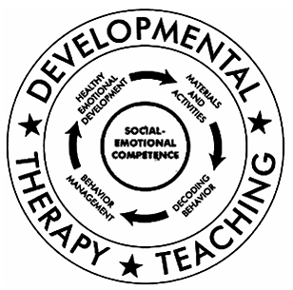
??? Questions ???
Let us hear from you!
dti@developmentaltherapyinstitute.org

